Slide 1

An Internship Report Review-1
Final Year(2020-2024)
By
Muskan Patel (PA-05)
PRN - 1032200264
Branch: Mechanical Engg.
Guide: Asst. Prof. Ashish Pawar

Slide 2

CONTENT
Introduction of Company
Department of work & Role
Internship Plan and Daily tasks
Projects/ Problem Statements and Solutions
References

Slide 3
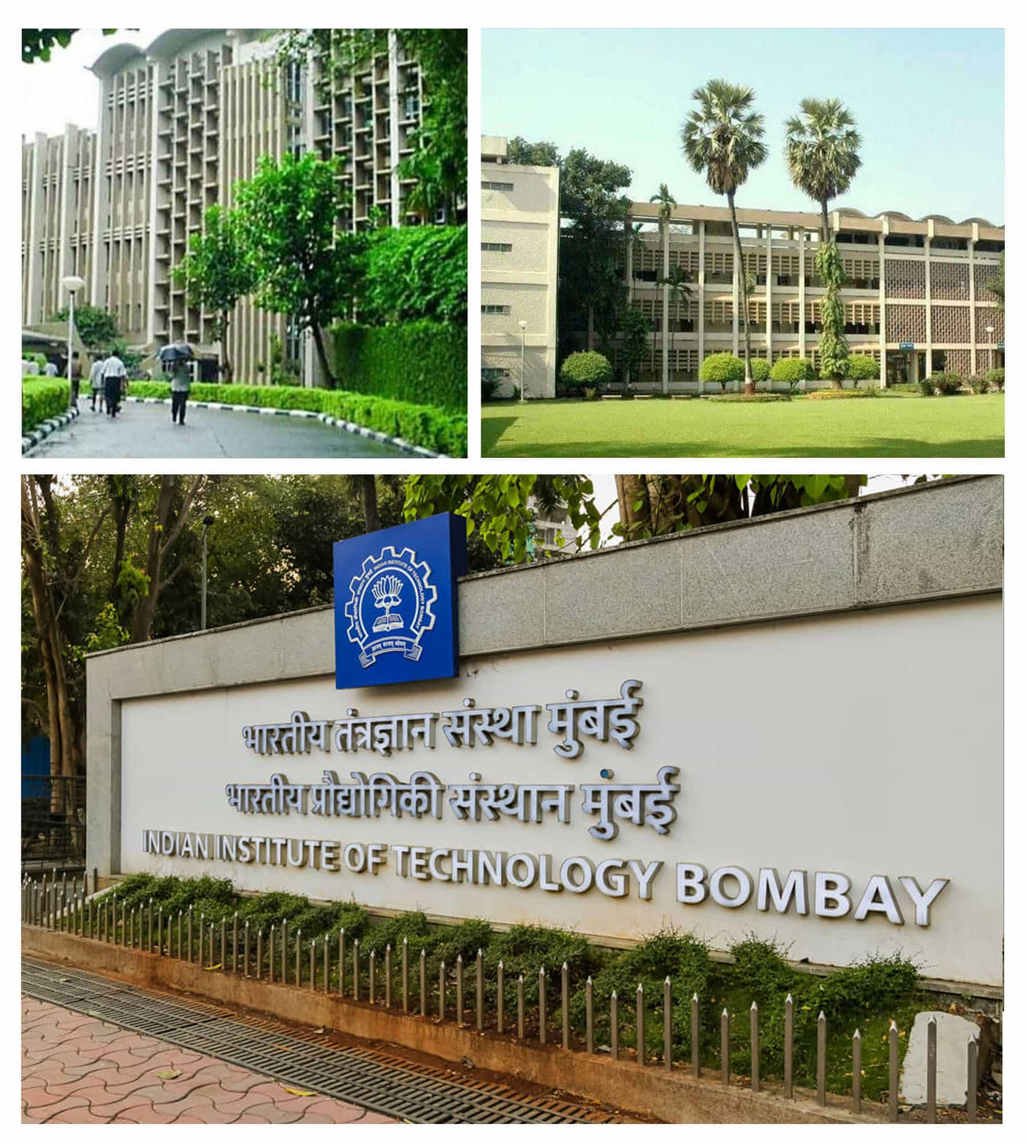
INTRODUCTION OF COMPANY
IIT Bombay: India's Premier Technical University
Established in 1958 with foreign assistance.
Received UNESCO funds from the Soviet Union.
Designated an 'Institute of National Importance' by Parliament in 1961.
Governed by a board of governors, chaired by the president of India.
Operates under the guidance of the IIT Council, established by India's Ministry of Education.
Known for excellence in engineering education and research.
Offers innovative short-term courses, continuing education, and distance learning.
Faculty members have received prestigious awards.
Located in Powai, Mumbai offering a residential experience.

Slide 4
DEPARTMENT AND ROLE
I am currently serving as a research intern in the Department of Mechanical Engineering, where I report to Prof. Vivek Sangwan, the esteemed professor in the department of mechanical engineering at IITB.
My responsibilities encompass a balanced blend of CAD designing and testing of mechanisms in balancing a torso of bipedal walking robot.
My typical workday spans 8 and half hours, providing flexibility within the timeframe of 9:30 AM to 6:00 PM to accommodate various testing and development activities. Internship Duration is of 4 months.
At the end of each project , a comprehensive report must be written in order to conclude the project successfully or to further improvise it.

Slide 5
PROBLEM STATEMENTS
To obtain the dynamical equations of the balanced link and simulate the system using MATLAB.
To design a torso balancing mechanism using solidworks.
Manufacture the biped and perform torso attitude control and also implement controller.
Integrating this system with the ankle impulse delivery mechanism.

Slide 6
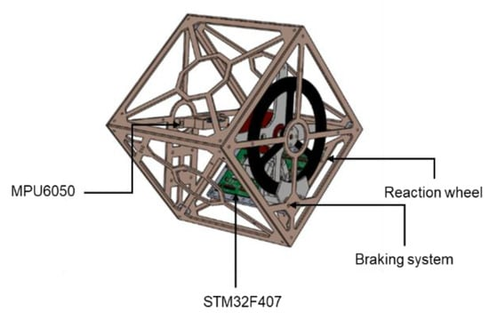
WEEK-1
Introduction to IITB, goals, mission and vision of the mechanical engineering and the dedicated project.
Glimpse of ongoing project (Design and manufacturing of bipedal walking robot).
Collected 10 research papers based on three major concepts:
Cubli
Flywheels
Biped

Slide 7
WEEK-2
Derived the equation to find the radius of the flywheel depending on the frame inertia as to balance the frame, the moment of inertia of frame should be equal to the inertia of the flywheel.
Derived the dynamical equations of an inertia wheel on which torque is applied. Also, learnt the basics of ODE45 solver in MATLAB by simulating the derived equation in MATLAB using ode45 and pd controller.

Slide 8
WEEK-3
Started with the solidworks design of the parts involved in the complete desired biped system. Successfully made major parts of the biped which are the three links – two being 2040 aluminum profiles and one is the frame also called torso which will have two BLDC motors mounted over its diagonal extreme ends.
Understood the basics of the XEP100 microcontroller by studying the pins and functions of them using the datasheet given. Also, understood that to balance the torso the speed and direction control of motor is the most important part.
Successfully derived the dynamical equations of the given system using two methods to verify them simultaneously. Also, verified both of the equations.

Slide 9
WEEK-4
Successfully interfaced the potentiometer with XEP100 and also understood the concept of analog to digital converter.
Firstly, performed energy check by keeping the system torque=0 first, then torque=constant and then a sine function. The equations are hence verified and then simulated the system.
All the parts of the system are designed and also started with the assembly, deciding the size of nuts and bolts, angle joints and bearings.

Slide 10
WEEK-5
Finalized the design after making the required changes in the cad.
Read about PWM signal and understood the purpose of PWM and also that it will be used in motor speed and direction control.
Successfully completed the given task and plotted the PWM signals with different duty cycles on oscilloscope.

Slide 11
WEEK-6
Started with the finalization of the parts of the complete biped model.
Worked on the equation derivation of the given system using lagrangian method first but encountered few issues then also derived equations using newton’s method but obtained two different equations of same system by two different methods.

Slide 12
WEEK-7
Found the error and resolved the equations and obtained the output as required in the matlab ode45.
Started with interfacing Arduino uno with BLDC motor and Simonk 30A ESC, potentiometer and MPU 6050 gyroscope individually first. Also, got familiar with Teensy 4.1 microcontroller to replace Arduino uno with Teensy 4.1 later.

Slide 13
REFERENCES
https://www.iitb.ac.in/safety/en/about-iit-bombay
https://ethz.ch/content/dam/ethz/special-interest/mavt/dynamic-systems-n-control/idsc-dam/Research_DAndrea/Cubli/Cubli_IROS2012.pdf
https://www.mdpi.com/2226-4310/8/9/252
https://www.researchgate.net/publication/224323192_Satellite_attitude_control_using_three_reaction_wheels
https://in.mathworks.com/help/matlab/ref/ode45.html
https://media.digikey.com/pdf/Data%20Sheets/Adafruit%20PDFs/4622_Web.pdf
https://invensense.tdk.com/wp-content/uploads/2015/02/MPU-6000-Datasheet1.pdf
https://www.rhydolabz.com/documents/26/BLDC_A2212_13T.pdf

Slide 14
THANK YOU!!

